Slide 1
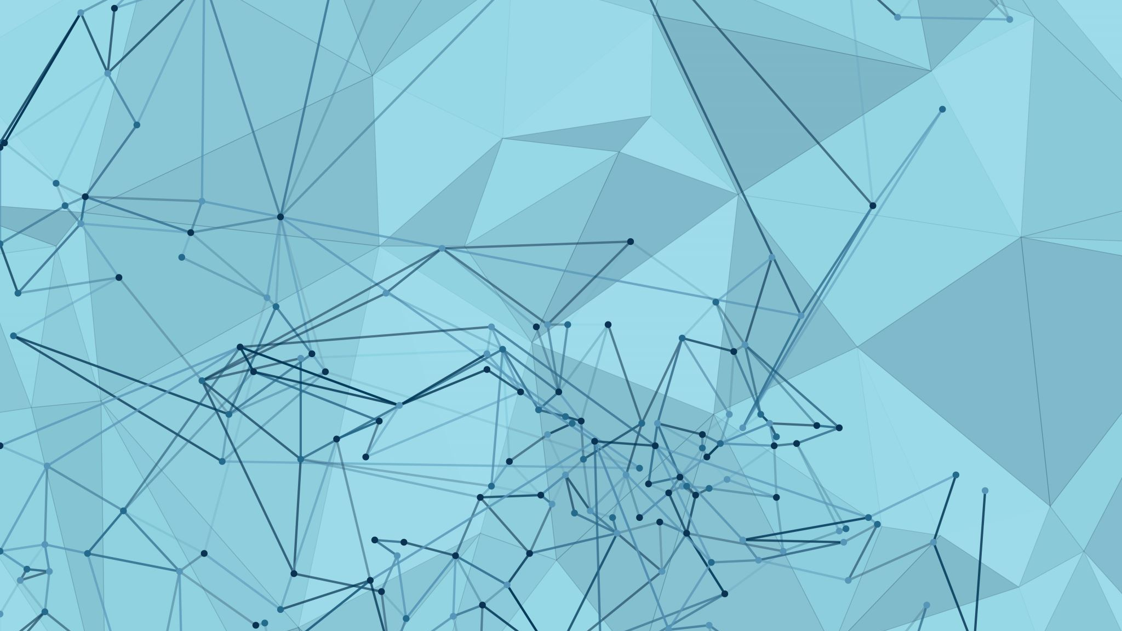
CourtMetrics – Unlocking Tennis Insights with Machine Learning
Team Members:
Gautham Gali
Ashutosh Reddy Pochamreddy
Atharva Rajendra Sardar
Lokesh Devendra Satpute
Professor. Soheil Sibdari

Slide 2
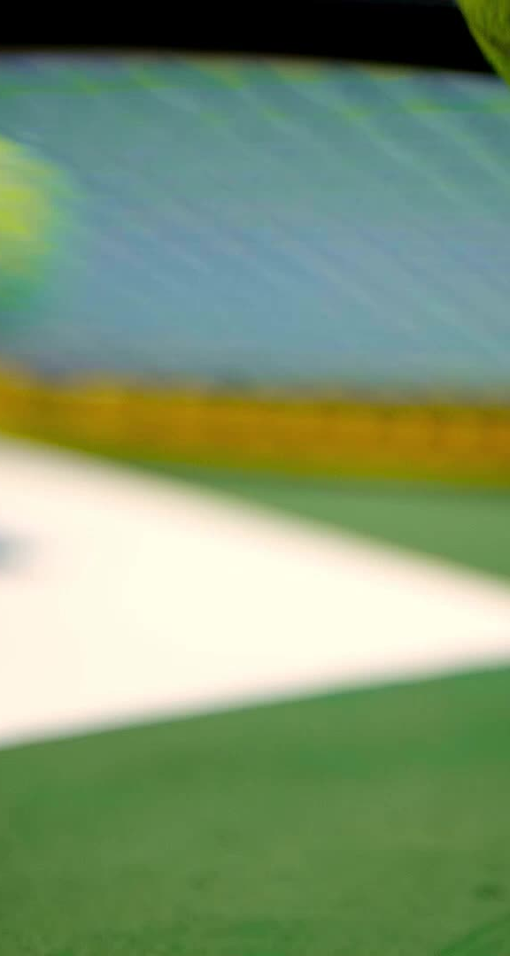
Overview
Objective:
Enhance tennis video analysis through deep learning-based detection of player actions, ball tracking, and court keypoints to provide comprehensive match insights.
Ball and Player Tracking: Successfully integrated tracking mechanisms for both ball movement and player actions within match videos.
Court Keypoints Detection: Developed a mini-court overlay for enhanced visualization.
Player Action Analysis: Completed player action detection.
Player Statistics Analysis: integrated player vs player statistical analysis using ATP data and Utilized Azure Openai Services.
Deployment & Optimization: Deployed Our Services Using Azure VM and Azure OpenAI service.

Slide 3
Dataset
Size: 8,841 images (75% training, 25% validation)
Resolution: 1280 × 720
Content: Hard, clay, and grass courts
Source: Semi-automated extraction from YouTube highlights Link: https://drive.google.com/file/d/1lhAaeQCmk2y440PmagA0KmIVBIysVMwu/view?usp=drive_link

Slide 4
Dataset
Tennis Player Actions Dataset for Human Pose Estimation
Size: 500 images each Resolution: 1280 × 720
Content: The actions in this dataset, the action categories name in COCO-format is in brackets:
1. backhand shot (backhand)
2. forehand shot (forehand)
3. ready position (ready_position)
4. serve (serve) We use COCO-Annotator to annotating and categorizing human actions
["nose", "left_eye", "right_eye", "left_ear", "right_ear", "left_shoulder", "right_shoulder", "left_elbow", "right_elbow", "left_wrist", "right_wrist", "left_hip", "right_hip", "left_knee", "right_knee", "left_ankle", "right_ankle", "neck"]
Source: Mendeley Data Link: https://data.mendeley.com/datasets/nv3rpsxhhk/1

Slide 5
Tools
FrontEnd: HTML, CSS, JS
Backend: Flask, PostgresDB, python, Azure Open AI
ML models: yolov8, Tracknet CNN, ResNet-18
Azure Services: Azure Virtual Machine, Azure Open AI, Azure Virtual net, Azure DNS, Azure Resource groups, Azure public IP
LLM: gpt-4o (version:2024-08-06)
Visualization: seaborn, matplotlib
IDE: Visual Studio Code, Azure OpenAI Service
Other: Trello, kanban, Jira
Communication: zoom, WhatsApp, slack

Slide 6
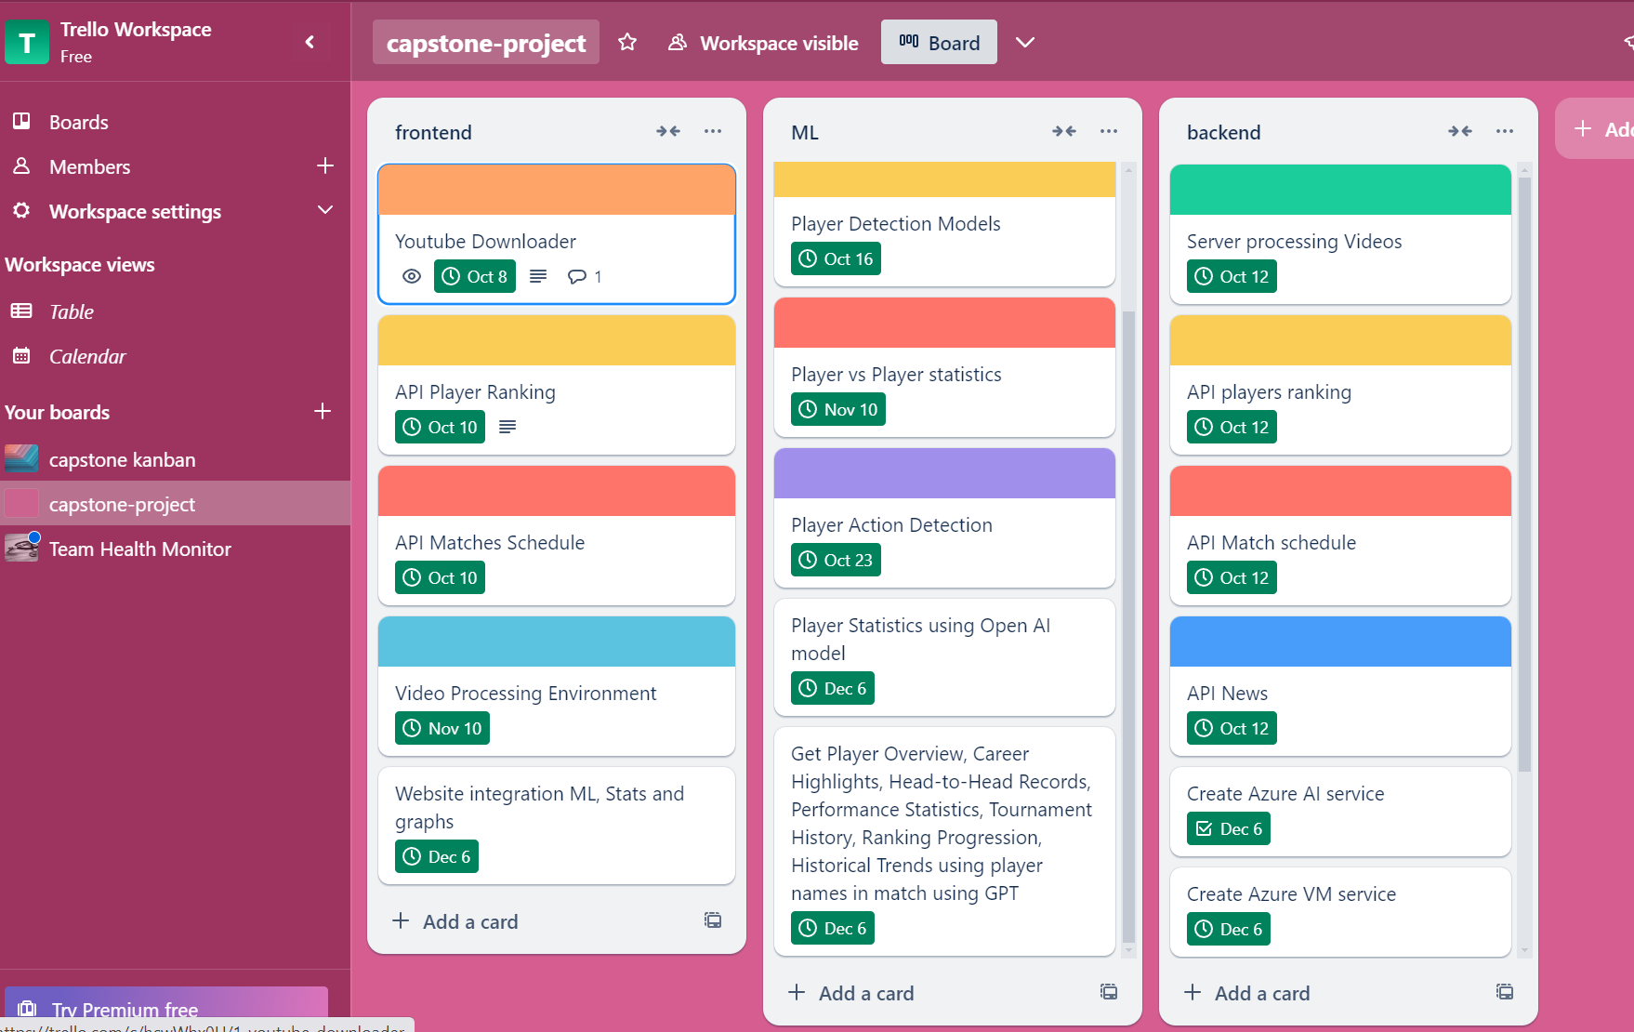
Sprint

Slide 7
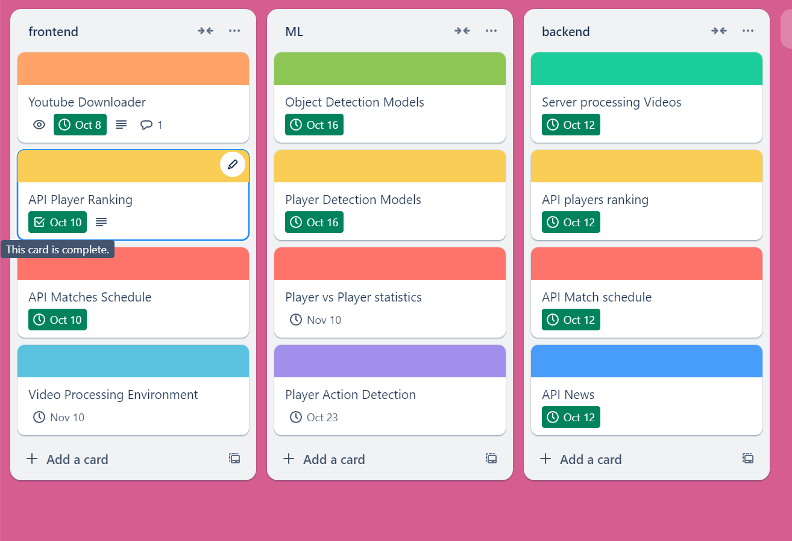
Sprint 1 Achievements
Completed:
Video download/upload feature
Player ranking API and match scheduling API
Backend server setup for video processing
Ongoing:
Player detection models and player vs. player statistics
Video processing framework (Due: Nov 10)

Slide 8
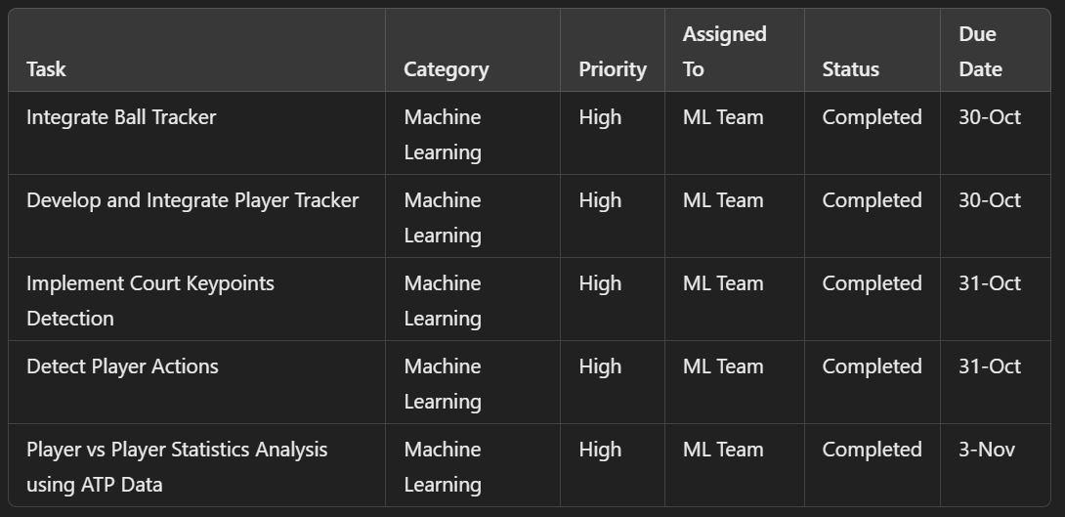
Sprint 2 Achievements
Completed:
Ball Tracker Integration: Successful tracking and monitoring of ball movement during match videos.
Player Tracker Integration: Accurate tracking of players within match videos for detailed analysis.
Court Keypoints Detection: Mini-court overlay with key points for enhanced match visualization.
Player Action Detection: Completed detection of key player movements.
Player vs Player Statistics Analysis: Integrated ATP data for comprehensive player comparisons.
Ongoing:
Integrating everything
Video processing framework (Due: Nov 20)

Slide 9
Sprint 3 Achievements
Completed:
Ball Tracker Integration: Successful tracking and monitoring of ball movement during match videos.
Player Tracker Integration: Accurate tracking of players within match videos for detailed analysis.
Court Keypoints Detection: Mini-court overlay with key points for enhanced match visualization.
Player Action Detection: Completed detection of key player movements.
Player vs Player Statistics Analysis: Integrated ATP data for comprehensive player comparisons.
Integrated Azure VM and Deployment.

Slide 10
Sprint Retrospective & Next Steps

Slide 11
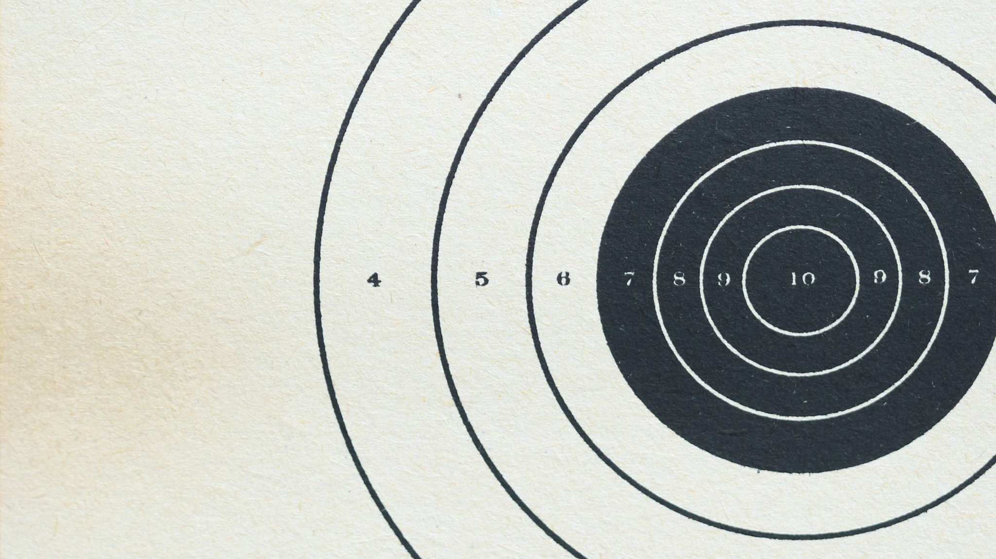
Demo

Slide 12
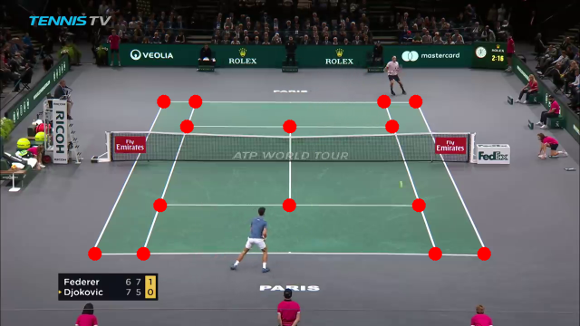
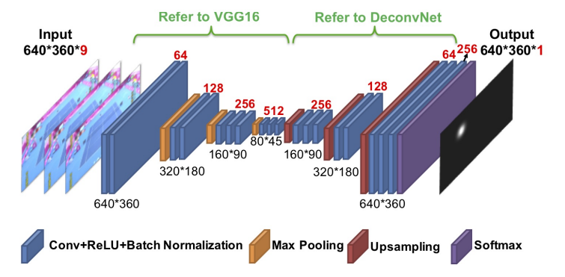
Model Architecture
Tennis Court Detection Model:
TrackNet architecture Neural network
Input: 1 image; Output: 15 channels (14 keypoints + court center)
Input/Output resolution: 640 × 360

Slide 13
Model Architecture
Tennis Player and ball tracking:
YOLO (You Only Look Once): Real-time object detection system with high speed and accuracy.
YOLOv8: Enhanced version with an anchor-free design and improved feature extraction.

Slide 14
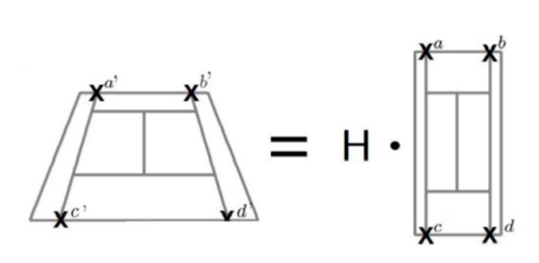
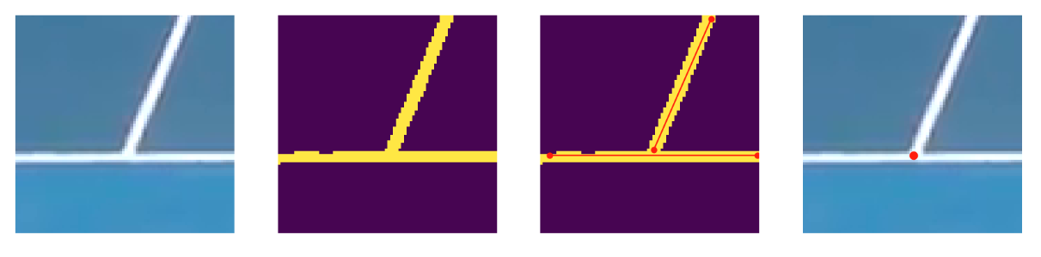
Post-Processing Techniques
Refining Keypoints:
Extract white pixels, detect lines, and use intersections to correct predictions.
Homography Adjustment:
Apply homography matrix to compare and shift predicted keypoints for occluded areas.

Slide 15
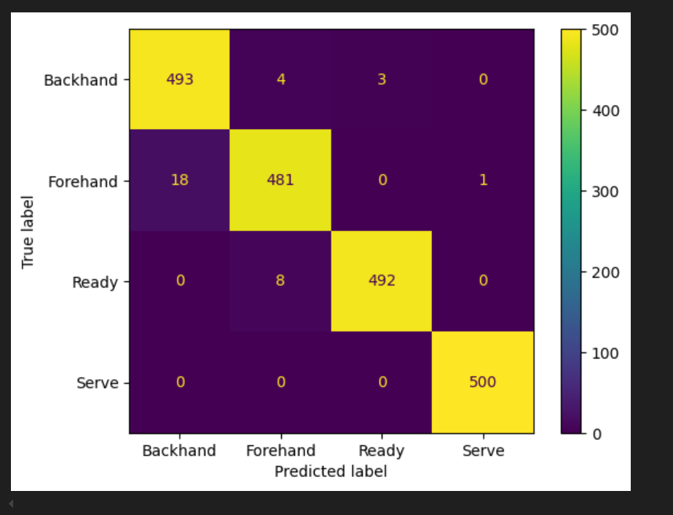
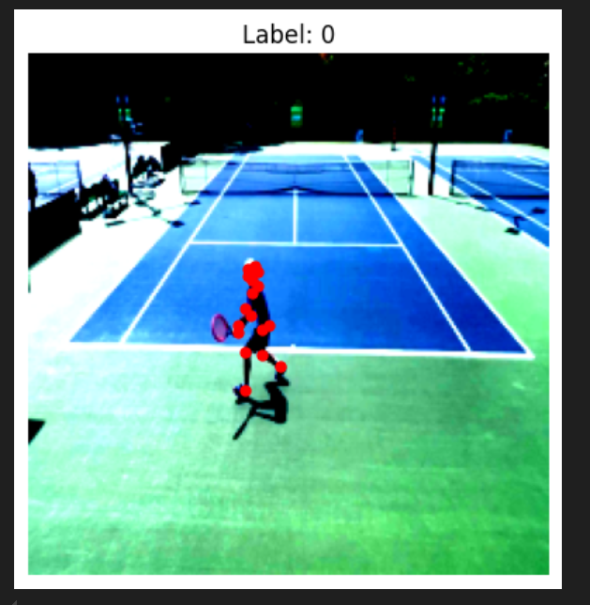
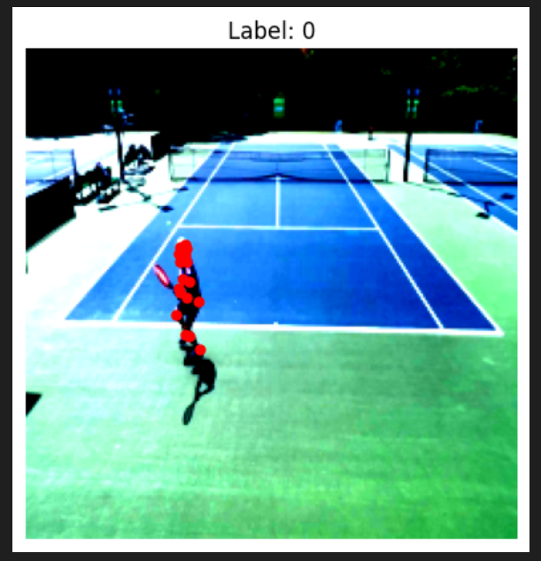
Model Architecture
Player Action Detection Model:
ResNet-18 Backbone: Pretrained ResNet-18 used for feature extraction with a modified output layer.
Custom Heads:
Keypoint Head: Predicts 18 (x, y) keypoints.
Classification Head: Classifies actions (Backhand, Forehand, Ready Position, Serve).
Input-Output Flow: Takes RGB images as input; outputs pose keypoints and action logits.

Slide 16
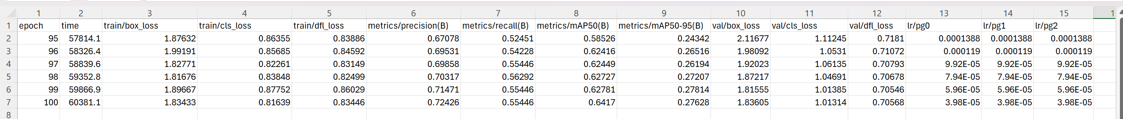
Model Results
Tennis Ball Detection Model:

Slide 17
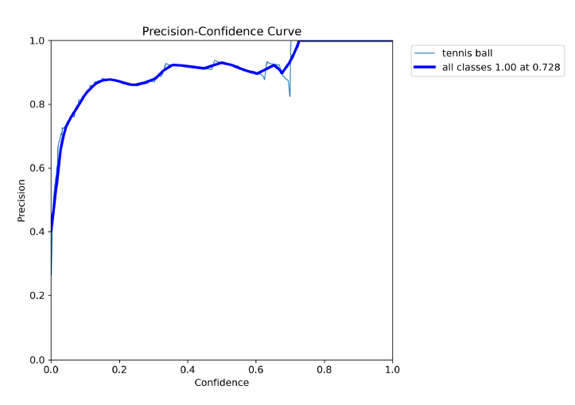
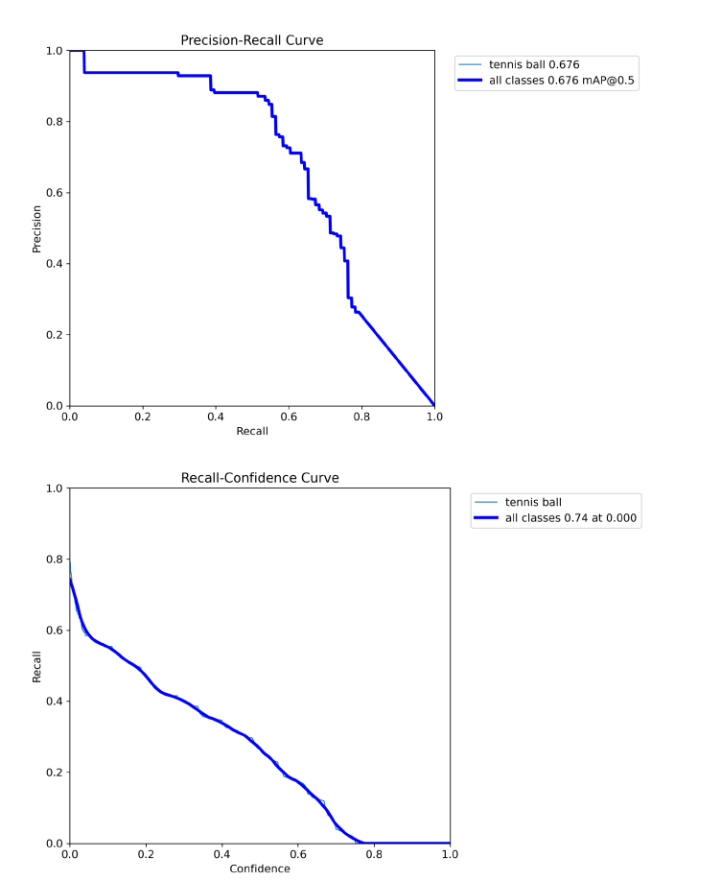
Model Results
Tennis Ball Detection Model:

Slide 18
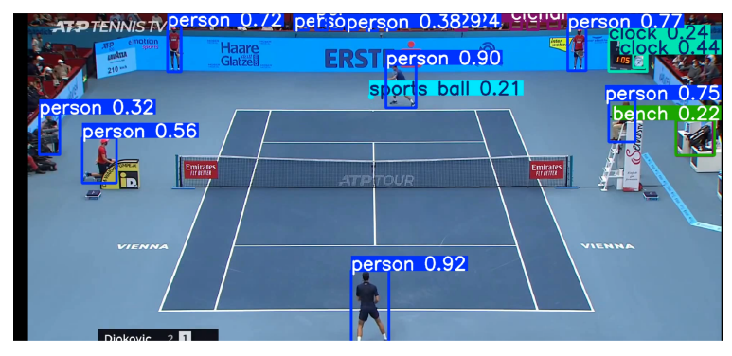
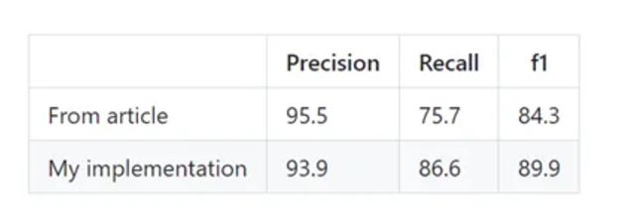
Model Results
Tennis Player Detection:

Slide 19
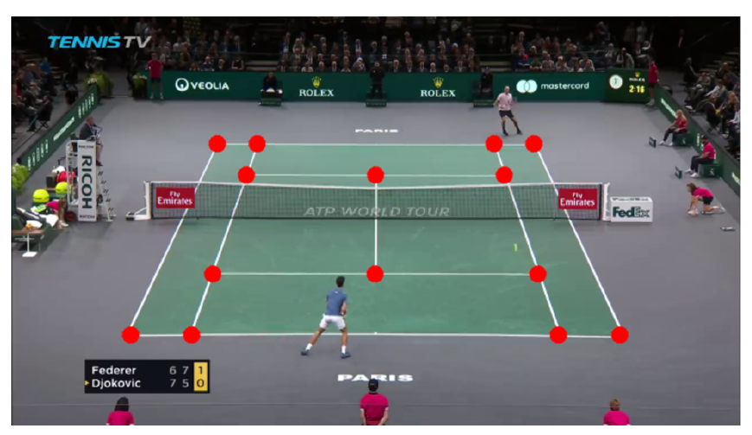
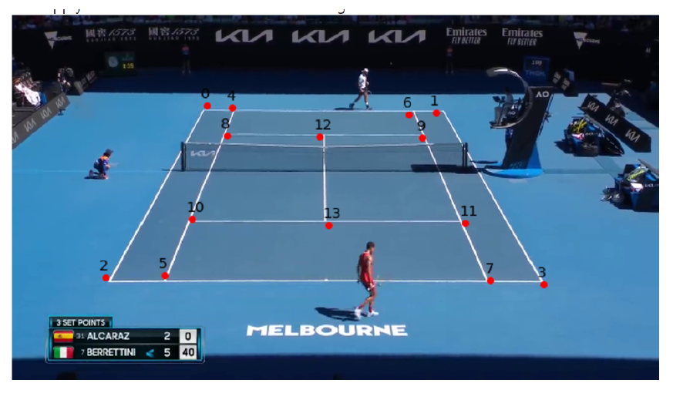
Model Results
Court Detection Model

Slide 20
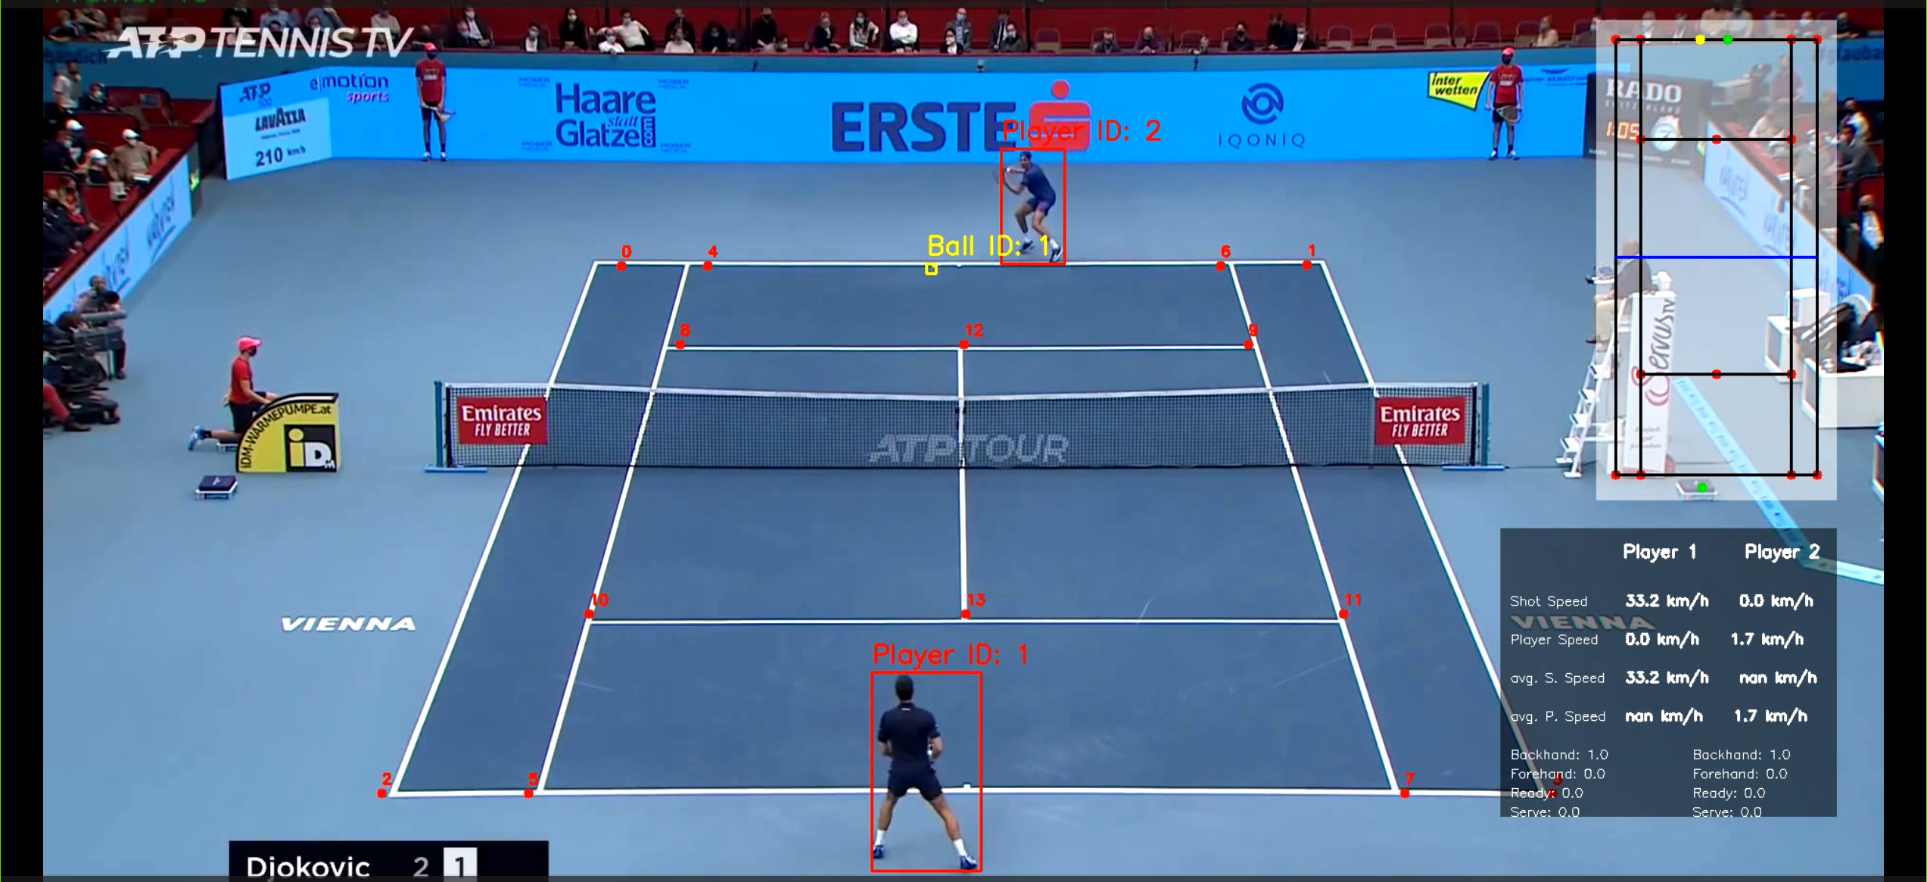
Mini map and dashboard

Slide 21
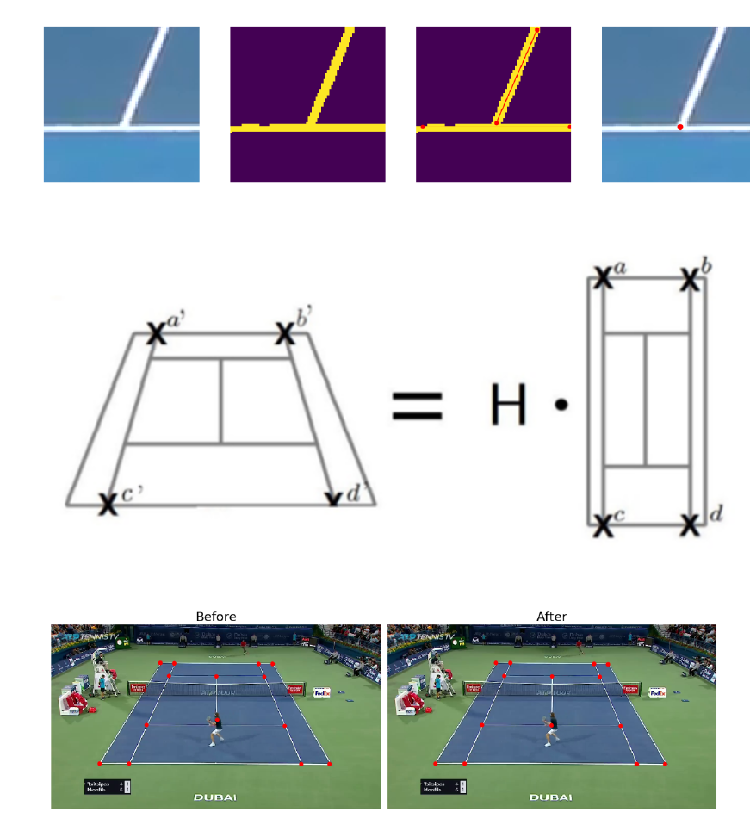
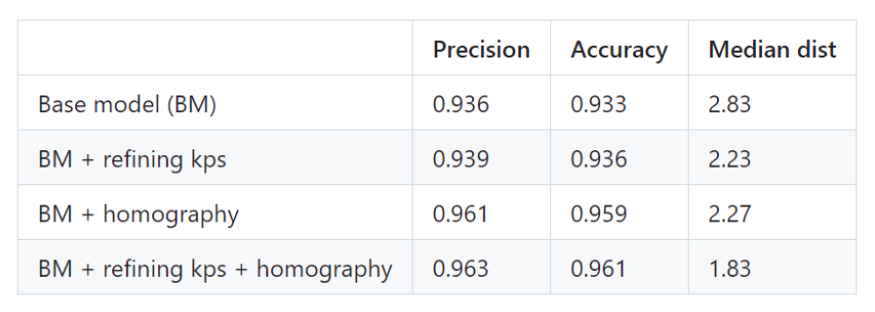
Model Results

Slide 22
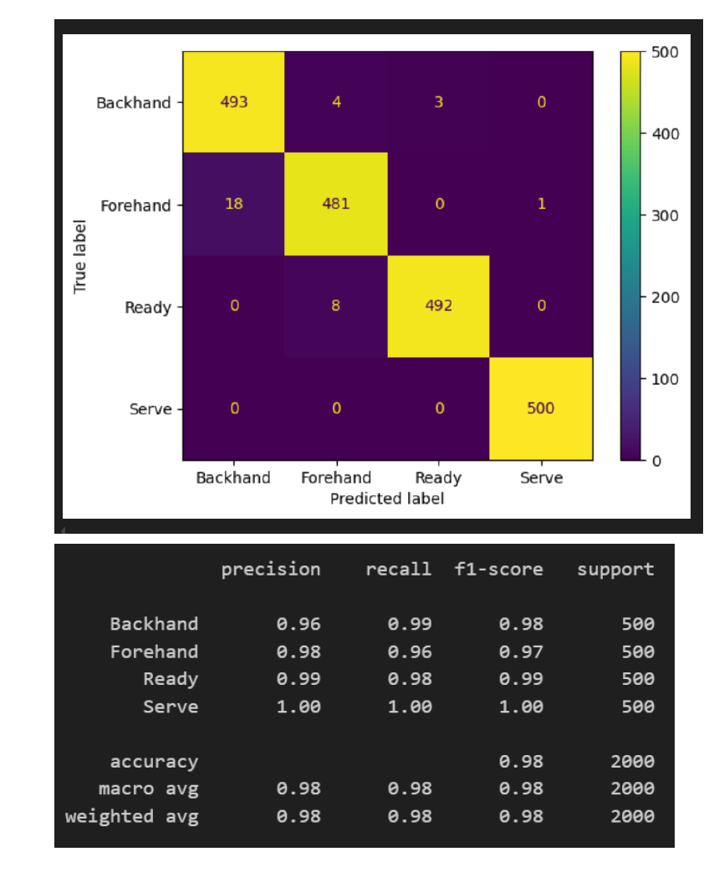
Model Results
Player Action Detection

Slide 23
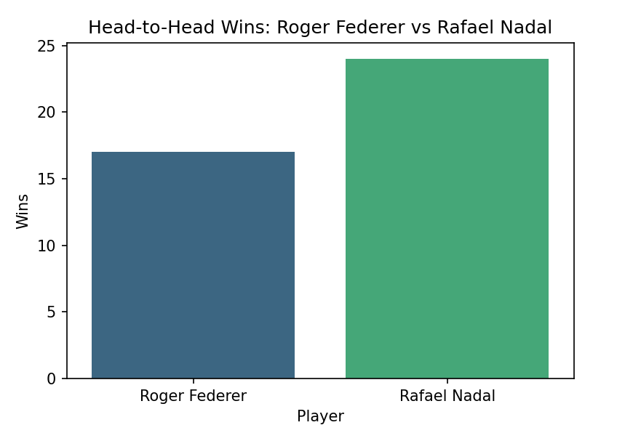
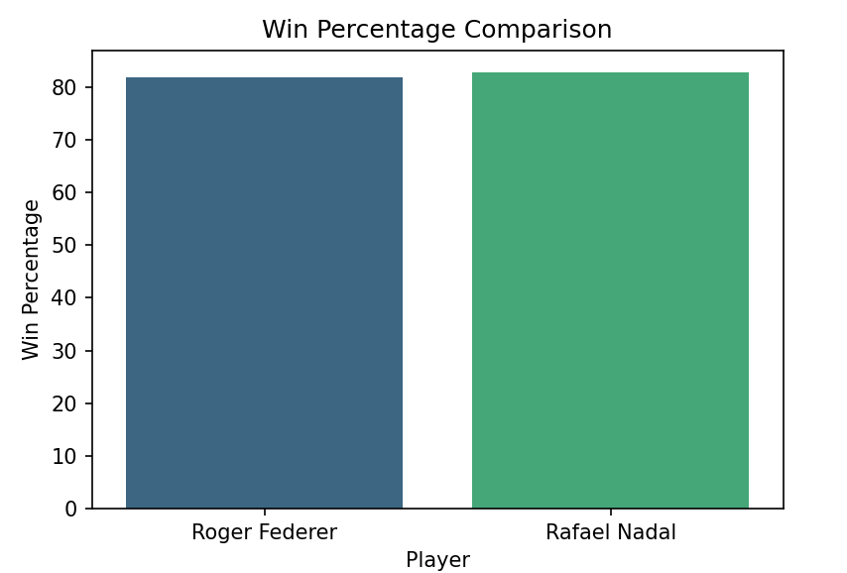
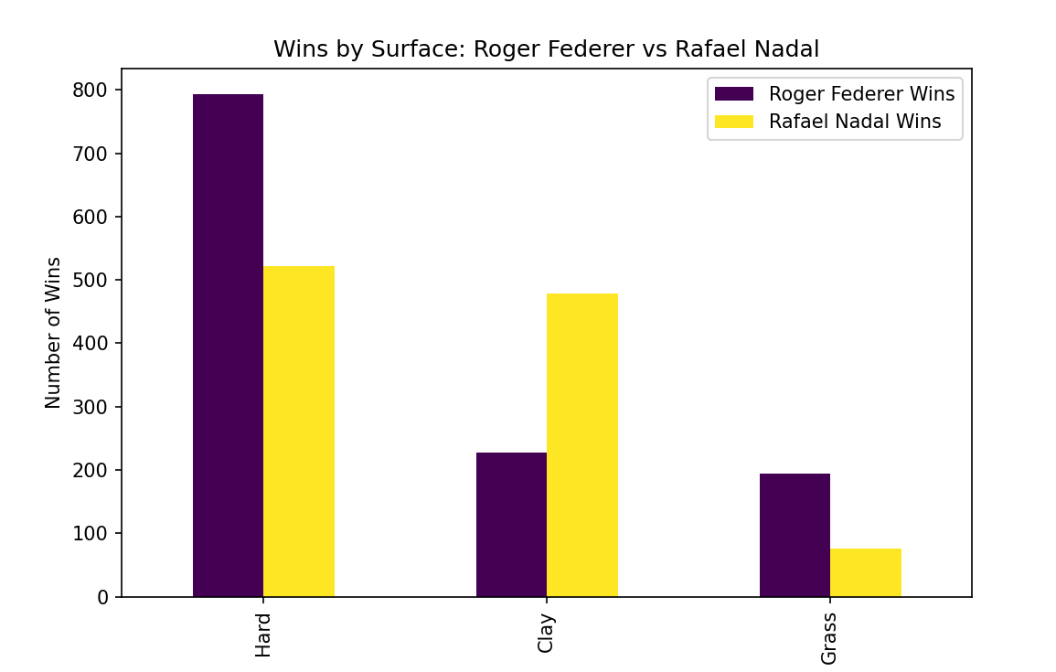
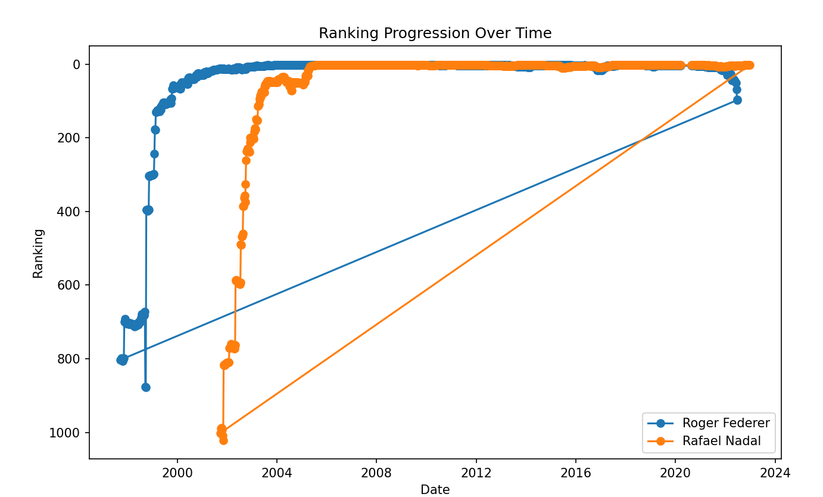
Player vs Player statistics
Head-to-Head Wins Bar Chart:
Comparison of head-to-head wins between Federer and Nadal.
Win Percentage Comparison:
Bar chart illustrating win percentages of both players.
Wins by Surface:
Bar chart comparing wins on different surfaces (Hard, Clay, Grass).
Ranking Progression:
Line chart showing ranking progression over time for both players.

Slide 24
Player vs Player statistics

Slide 25
Player vs Player statistics

Slide 26
Player vs Player statistics

Slide 27
Player vs Player statistics

Slide 28
Player vs Player statistics

Slide 29
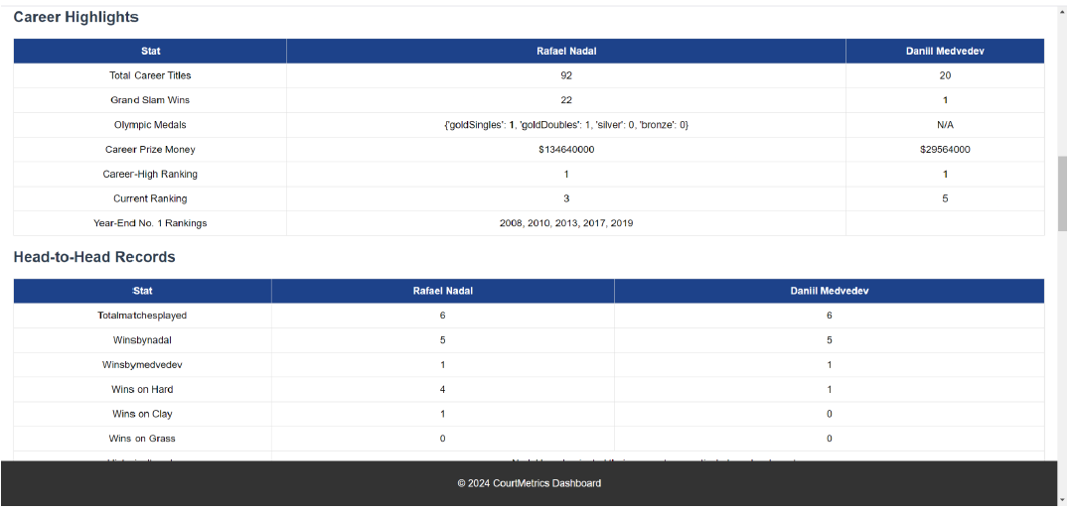
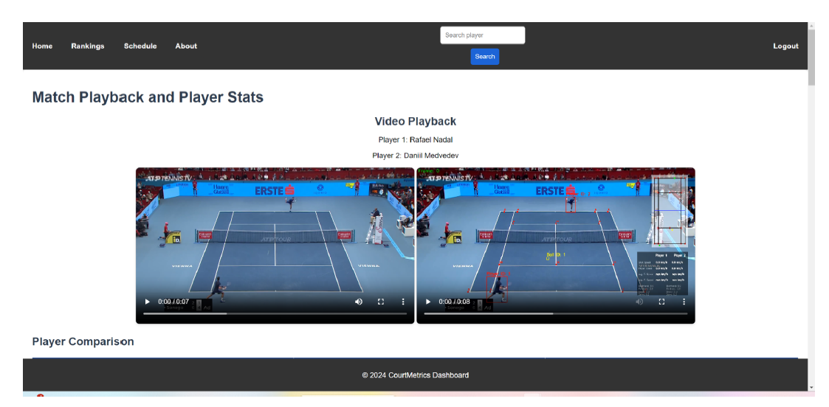
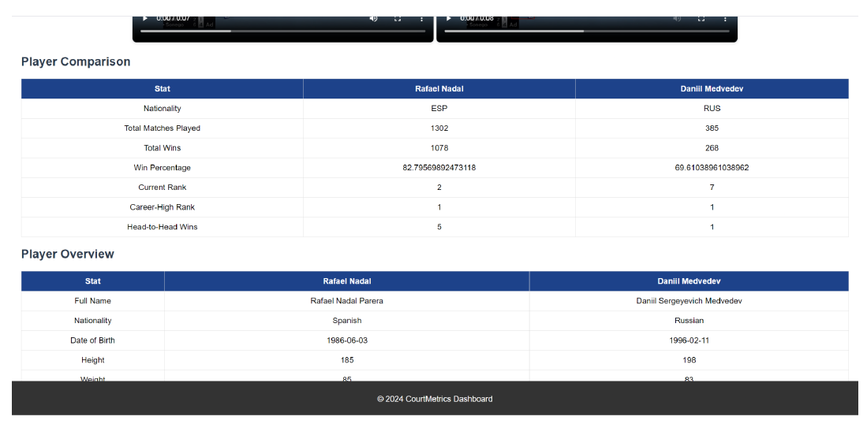
Backend and Frontend Implementation
Backend:
Video upload and processing API
APIs for player ranking, match schedule
Azure OpenAI service for Player Statistics
Frontend:
YouTube Video Downloader & Uploader (Completed)
Player ranking system
Match scheduling page

Slide 30
Azure openAi service

Slide 31
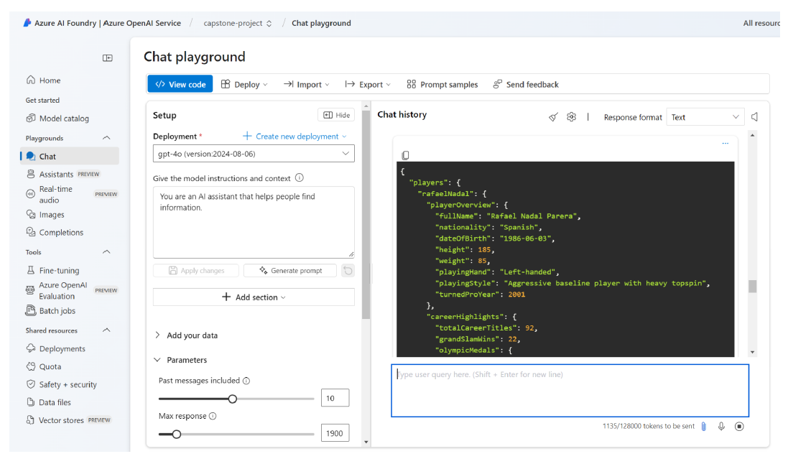
Azure openAi service

Slide 32
Challenges & Solutions
Model Accuracy:
Issue: Lighting and camera angle variations
Solution: Extra testing and data collection
Backend Performance:
Issue: Video upload latency
Solution: Optimized code and implemented load balancing

Slide 33

Thank You

